Slide 1

PollPulse: A Real-Time Interactive Polling Platform
Project Review 1
Prepared By
-Samir Dhakal (RA2411003012590)
-Aayusha Kuikel (RA2411003012589)
SRM University - Semester 3
August 7, 2025

Slide 2

Introduction: Redefining Real-Time Engagement
Online polling systems are crucial for instant feedback, but traditional methods often fall short in real-time capabilities and efficiency.
PollPulse: Our Innovative Solution
A modern, web-based platform designed for real-time interaction.
Built with a robust tech stack: Java & Spring Boot for the backend and React for a dynamic frontend.

Slide 3
Addressing Current Polling Challenges
Existing polling tools often struggle with cost, user-friendliness, and the lack of immediate updates. Many are proprietary, limiting adaptability for academic or event-specific needs.
The Core Problem
PollPulse's Mission
A significant gap exists for a lightweight, real-time, and easily customizable feedback platform.
To deliver an intuitive, open-source, and real-time polling solution that overcomes these limitations.

Slide 4
Abstract
PollPulse is a real-time web-based polling system designed to simplify live feedback collection in classrooms, events, and meetings. Built with React and Spring Boot, it offers instant voting, live result updates using WebSockets, and features like anonymous voting, auto-closing polls, and secure data storage. PollPulse is intuitive, scalable, and ideal for academic and organizational use.

Slide 5
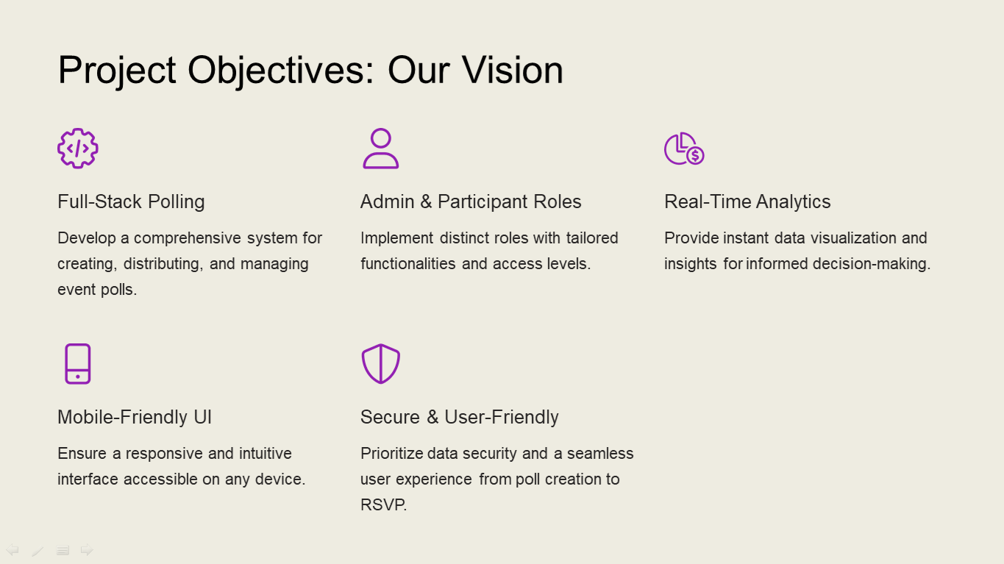
Project Objectives: Our Vision
Intuitive Web Interface
1
Design a user-friendly frontend for seamless poll creation and participation.
Robust Backend Development
2
Build a scalable Spring Boot backend for API management and data logic.
Real-Time Updates with WebSockets
3
Implement live poll result updates for immediate feedback.
Flexible Participation
4
Support both anonymous and identified voting options.
Automated Poll Management
5
Include features like auto-closing polls based on a set timer.
Secure Data Storage
6
Ensure all poll data is securely stored for future analysis and reference.

Slide 6
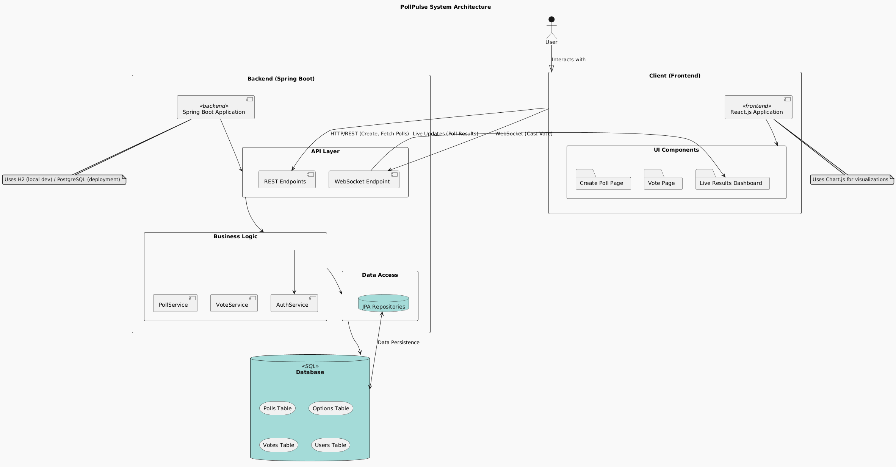
PollPulse System Architecture Diagram
PollPulse System Architecture Diagram

Slide 7
Architecture Breakdown: Core Components
Frontend (React)
Backend (Spring Boot)
Powers the user interface for creating polls and submitting votes, ensuring a smooth and responsive experience.
The core logic engine, managing APIs, business logic, and interactions with the database.
REST API
Database
The communication bridge, connecting the React frontend to the Spring Boot backend for data exchange and actions.
The persistent storage layer, securely holding all poll questions, options, and individual vote records.
WebSocket
Enables real-time, bidirectional communication between the server and clients for live poll result updates.

Slide 8
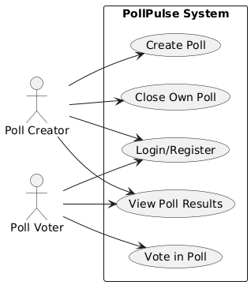
Use Case Diagram

Slide 9
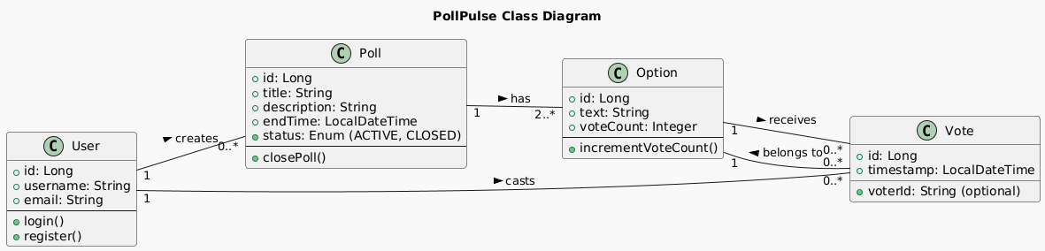
Class Diagram

Slide 10
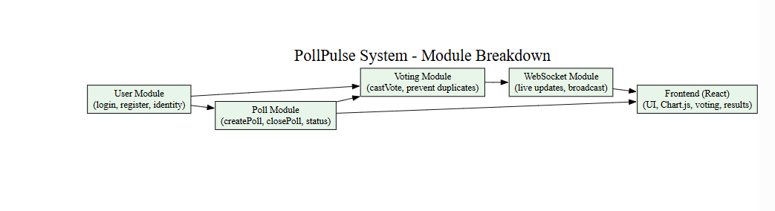
Module Breakdown

Slide 11
Key Tools and Technologies
Backend Stack
Frontend & Development
Java: Core programming language.
React: JavaScript library for building user interfaces.
Spring Boot: Framework for robust application development.
JavaScript: Frontend scripting language.
npm: Package manager for JavaScript.
Maven: Project build automation tool.
IntelliJ IDEA / VS Code: Integrated Development Environments.
PostgreSQL (or H2): Relational database management system.
Git & GitHub: Version control and collaboration.

Slide 12
Project Plan: Phased Development
Our development strategy is structured into distinct phases, ensuring a systematic and efficient build process.
Phase 1: Backend Foundations
Phase 2: Frontend Interface
Development of core APIs and initial database setup to establish the system's backbone.
Designing and implementing the user interface and core functionalities for seamless interaction.
Phase 3: Real-Time Integration
Phase 4: Testing & Refinement
Implementing WebSockets to enable dynamic, real-time updates for poll results.
Comprehensive testing, bug fixing, and performance optimization to ensure a polished product.

Slide 13





Potential "Wow" Factors: Enhancing User Experience
PollPulse is designed with several features that aim to significantly enhance user engagement and utility.
Live Updates & Dashboard
Flexible Participation
Automated Poll Closing
Real-time poll results and intuitive visual charts via WebSockets.
Options for anonymous or ID-based voting to suit various contexts.
Polls auto-close based on a set timer, streamlining event management.
Secure Data Storage
Intuitive UX Design
Ensuring all results are securely stored and accessible for future analysis.
A clean, user-friendly interface for effortless poll creation and participation.

